Slide 1
Enterprise Architectures
BS42, Lesson 3
Samuil Angelov

Slide 2
Lesson 3
Viewpoints:
Information structure
Process
Process co-operation
More on process models

Slide 3
Basic viewpoints
Information structure viewpoint

Slide 4
Information structure viewpoint
The Information Structure viewpoint = information models created in software design. It shows the structure of the information used in the enterprise.
In previous courses: data was modeled with ER (DB courses) or UML class structures (GSO)
Stakeholders: Domain and information architects

Slide 5
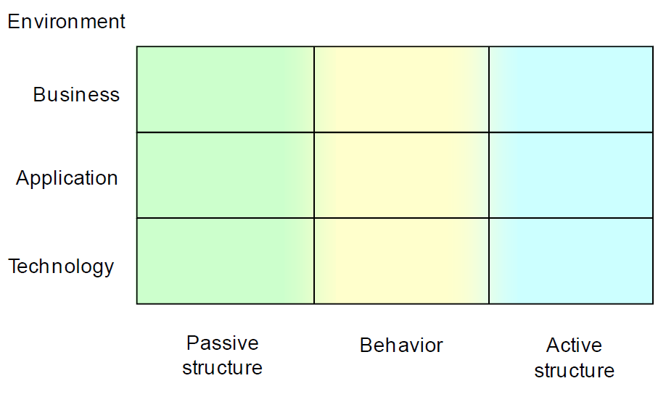
Positioning the viewpoints
Information

Slide 6

Notation
Business object: a passive information element that has relevance from a business perspective
Relations (a la UML – associations, aggregations, compositions, specializations)

Slide 7
Case example (text)
The business process of selling hard copy books consists of seven major parts:
Marketing and communication to attract new customers;
The management of customer accounts for storage of addresses and favorite books;
The handling of online orders for one or more books by a new or registered customer;
The billing of completed orders; for each order a bill is printed to be included with the package;
Packaging & shipping of paid orders; a shipping statement is printed to be included with the package;
Optionally a gift wrapping before the packaging for birthday gifts;
And finally the handling of returned products if the customer is not satisfied (BookOnline hopes to minimize the number of return claims of course)

Slide 8
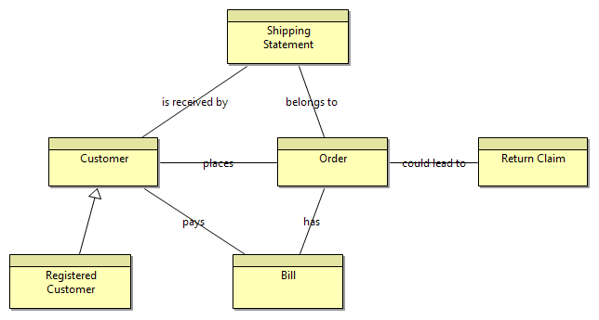
Case example (model)
Note that the information which is not relevant for the business (and eventually any applications that has to support it) is not depicted.

Slide 9
Semi-complex viewpoints
Process viewpoint

Slide 10
Business process viewpoint
The Business Process viewpoint is used to show:
The high-level structure and composition of a business process.
The relation with services that a business process offers to the outside world, showing how a process contributes to the realization of the company’s products.
Stakeholders: Process and domain architects, operational managers

Slide 11
Positioning the viewpoints
Business process

Slide 12
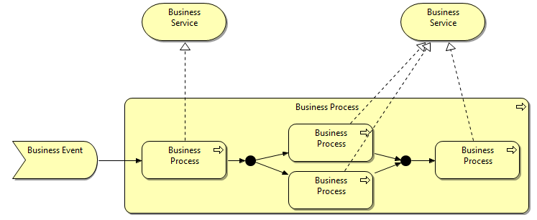
Notation
Relations: Junctions (split/merge and fork/join)
Business service that realizes one process
Relations: Junctions (split/merge and fork/join)
Relation: realization
Business event: something that happens and may influence business processes.
Relations:
triggers
Relations:
aggregation
Business process
Business process

Slide 13
Case example (text)
The business process of selling hard copy books consists of seven major parts:
Marketing and communication to attract new customers;
The management of customer accounts for storage of addresses and favorite books;
The handling of online orders for one or more books by a new or registered customer;
The billing of completed orders; for each order a bill is printed to be included with the package;
Packaging & shipping of paid orders; a shipping statement is printed to be included with the package;
Optionally a gift wrapping before the packaging for birthday gifts;
And finally the handling of returned products if the customer is not satisfied (BookOnline hopes to minimize the number of return claims of course)

Slide 14
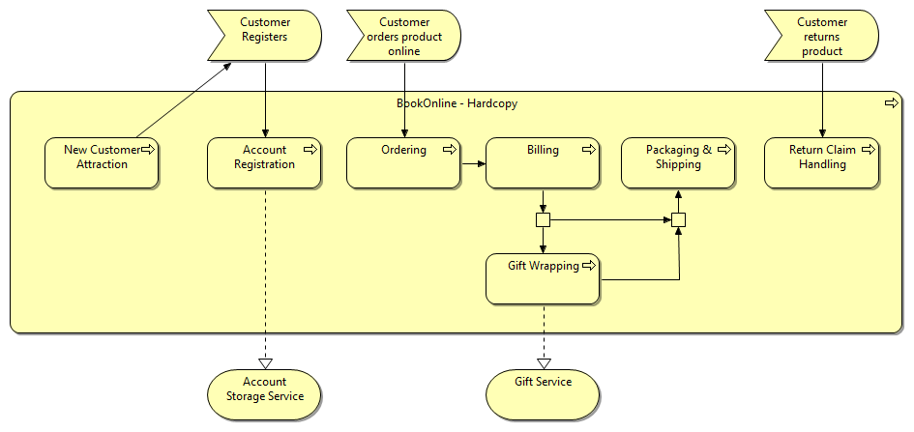
Case example (model)

Slide 15
Semi-complex viewpoints
Process Co-operation viewpoint (a la Fontys)

Slide 16
Business Process Co-operation Viewpoint
The Business Process Co-operation Viewpoint shows:
The assignment of business processes to roles, which gives insight into the responsibilities of the associated actors
The information used by the business process
Stakeholders: Process and domain architects, operational managers

Slide 17
Positioning the viewpoints
Process cooperation

Slide 18
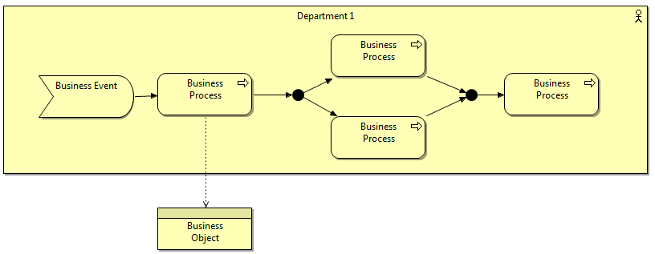
Notation
Business actor that performs the process
Relations:
access
Business object accessed by a process

Slide 19
Case example (text)
This is an integration view – therefore no further information is needed.

Slide 20
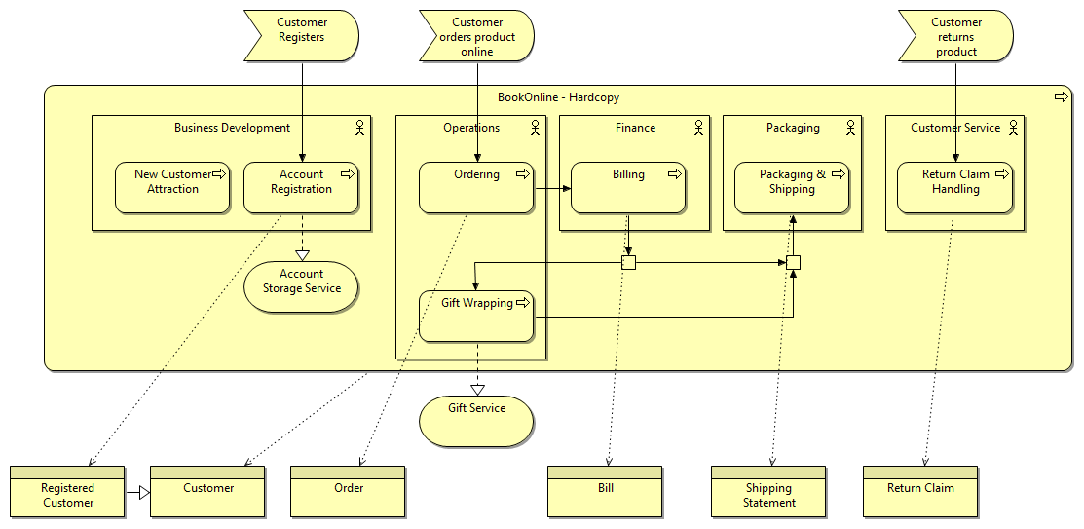
Example (model)

Slide 21
On process modeling

Slide 22
More on process modeling
Archimate is not specialized for process modeling. Its notation is quite simple.
There are other languages and notations which are much more sophisticated in process modeling – BPMN, activity diagrams, BPML, Petri nets, etc.
Therefore Archimate recommends that the detailed process model is made in one of these dedicated languages.
See chapter 7 in the book “Enterprise Architectures – A to Z”.

Slide 23
BPMN
The goal of BPMN is to provide a notation that is readily understandable by business users, business analysts, and technical developers.
BPMN creates a standardized bridge for the gap between the business process design and process implementation.
Has become a popular language.
It is rather rich (you can express many, many things with it). This makes it complex to study. We teach you a subset of it.
Notes:
Some argumentation why we offer BPMN and not any of the other options

Slide 24


BPMN - Notation
An event is something that “happens” during the course of a business process. There are three types of Events, based on when they affect the flow: Start, Intermediate, and End.
An activity is a generic term for work that the company performs. An activity can be atomic or nonatomic (compound).
A Sequence Flow is used to show the order that activities will be performed in a Process.

Slide 25

BPMN - Notation
A Gateway is used to control the divergence and convergence of multiple Sequence Flows. Thus, it determines branching, forking, merging, and joining of paths.
XOR – exclusive decision and merging.
OR—inclusive decision
AND—forking and joining
You use gateways in pairs (two of the same! – to open and close a gateway).

Slide 26
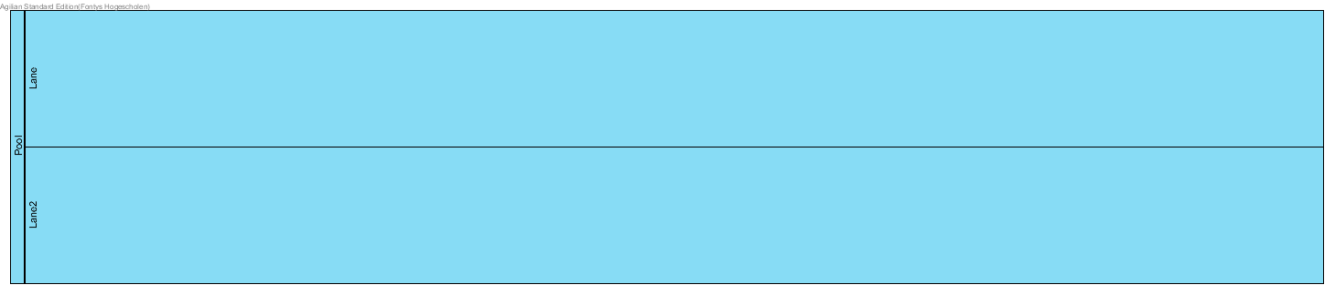
BPMN - Notation
A Pool is a “swimlane” - a graphical container for partitioning a set of activities from other Pools.
A Lane is a subpartition within a Pool. Lanes are used to organize and categorize activities.
Implicitly, pools and lanes are used to model roles (see lesson 3 and lesson 6)

Slide 27
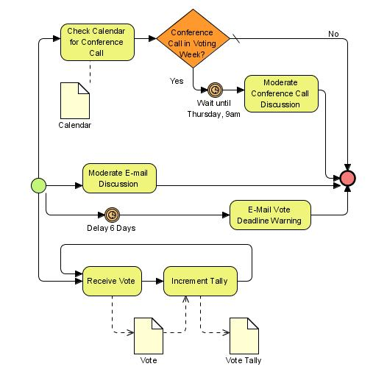
Example

Slide 28
Work on the case

